Slide 1

BANK ANALYSIS PROJECT
Group 3
Snimy Stephen
Devika Mishra
Subhash Chandra
Monisha
SHLOK DILIP PATHARE
Sahai
Bhagyashree Abhijeet Sant
Date 16th March 2024

Slide 2
OVERVIEW:
Our data analytics project focuses on analyzing a dataset related to loan transactions to derive insights that can inform strategic decision-making.
By leveraging data-driven techniques and statistical analysis, we aim to uncover patterns, trends, and relationships within the data.
The project encompasses various key performance indicators (KPIs), including year-wise loan amount statistics, grade and sub-grade wise revolving balance, payment behavior based on verification status, state-wise and month-wise loan status, loan amount by purpose and the relationship between home ownership and payment patterns.
Through this analysis, we seek to provide actionable insights to optimize loan management, mitigate risks, and enhance overall performance.

Slide 3
OBJECTIVE:
To analyze a loan dataset to derive actionable insights for strategic decision-making.
By identifying trends in year-wise loan amounts,
assessing risk by analyzing revolving balances across loan grades and subgrades,
comparing payment behavior based on verification status,
examining state-wise and month-wise loan status for geographical &temporal patterns.
investigating the impact of homeownership on payment behavior.
The project aims to provide stakeholders with valuable insights
To optimize lending practices,
To mitigate risks
To enhance overall performance in loan management.

Slide 4
Year wise loan amount Stats.
Grade and sub grade wise revolving balance.
Total Payment for Verified Status Vs Total Payment for Non-Verified Status
KPIs
State wise and month wise loan status.
Home ownership Vs last payment date stats.
Total funded amount of loans for each loan issuance year and purpose.
Loan status vs Loan Amount

Slide 5
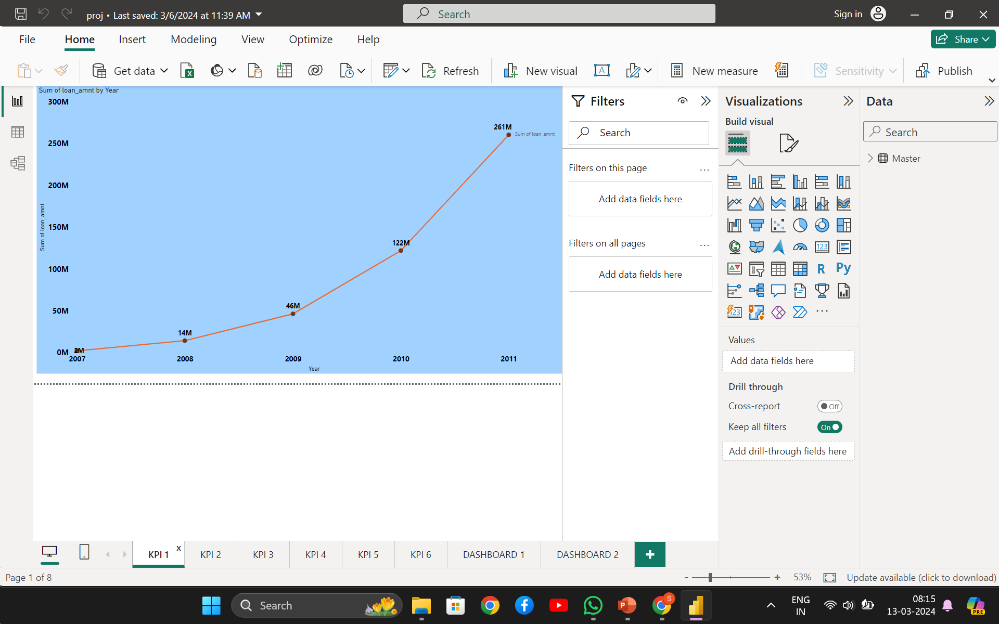

KPI 1: Analysis of loan amount over years
Trend Analysis:
Increase in loan amounts between years
2007
$12M
2008
$32 M
2009
$76M
2010
$139M
2011
Comparison Across Years:
You can compare the total loan amounts issued in different years to see if there are any significant changes or trends.
Seasonal Patterns:

Slide 6
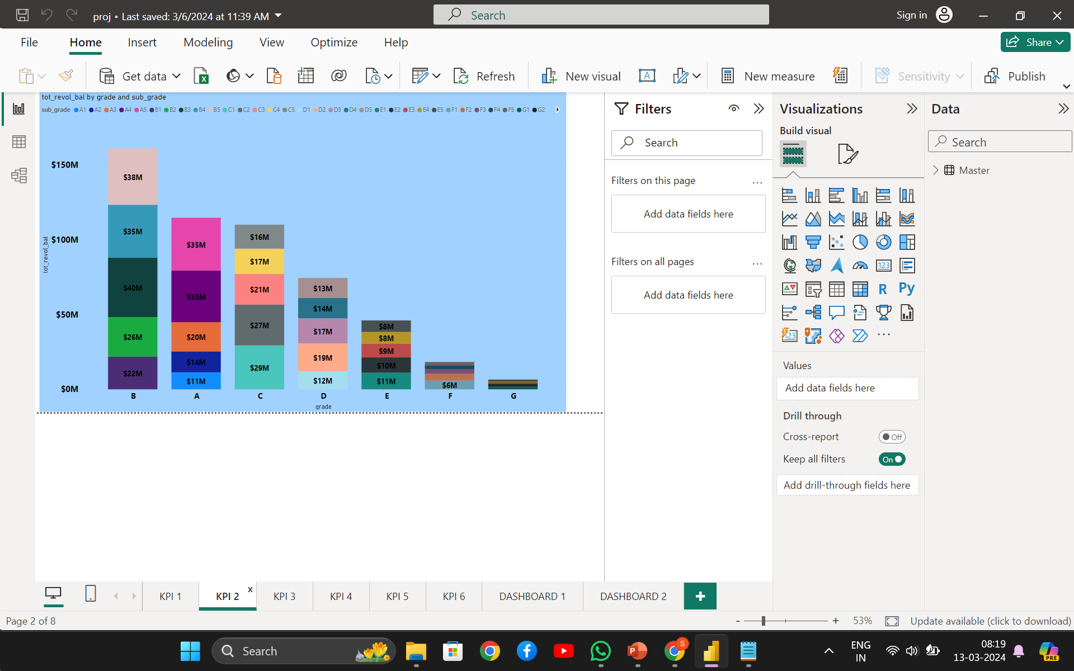
Kpi 2: Revolving balance distribution by grade and sub grade.
You can see the sum of revolving balances for each combination of grade and sub-grade, which can help in understanding the distribution of revolving balances across different grades and sub-grades.
Comparative Analysis:
Total amount for grade B is $161M which is highest among all grades.

Slide 7
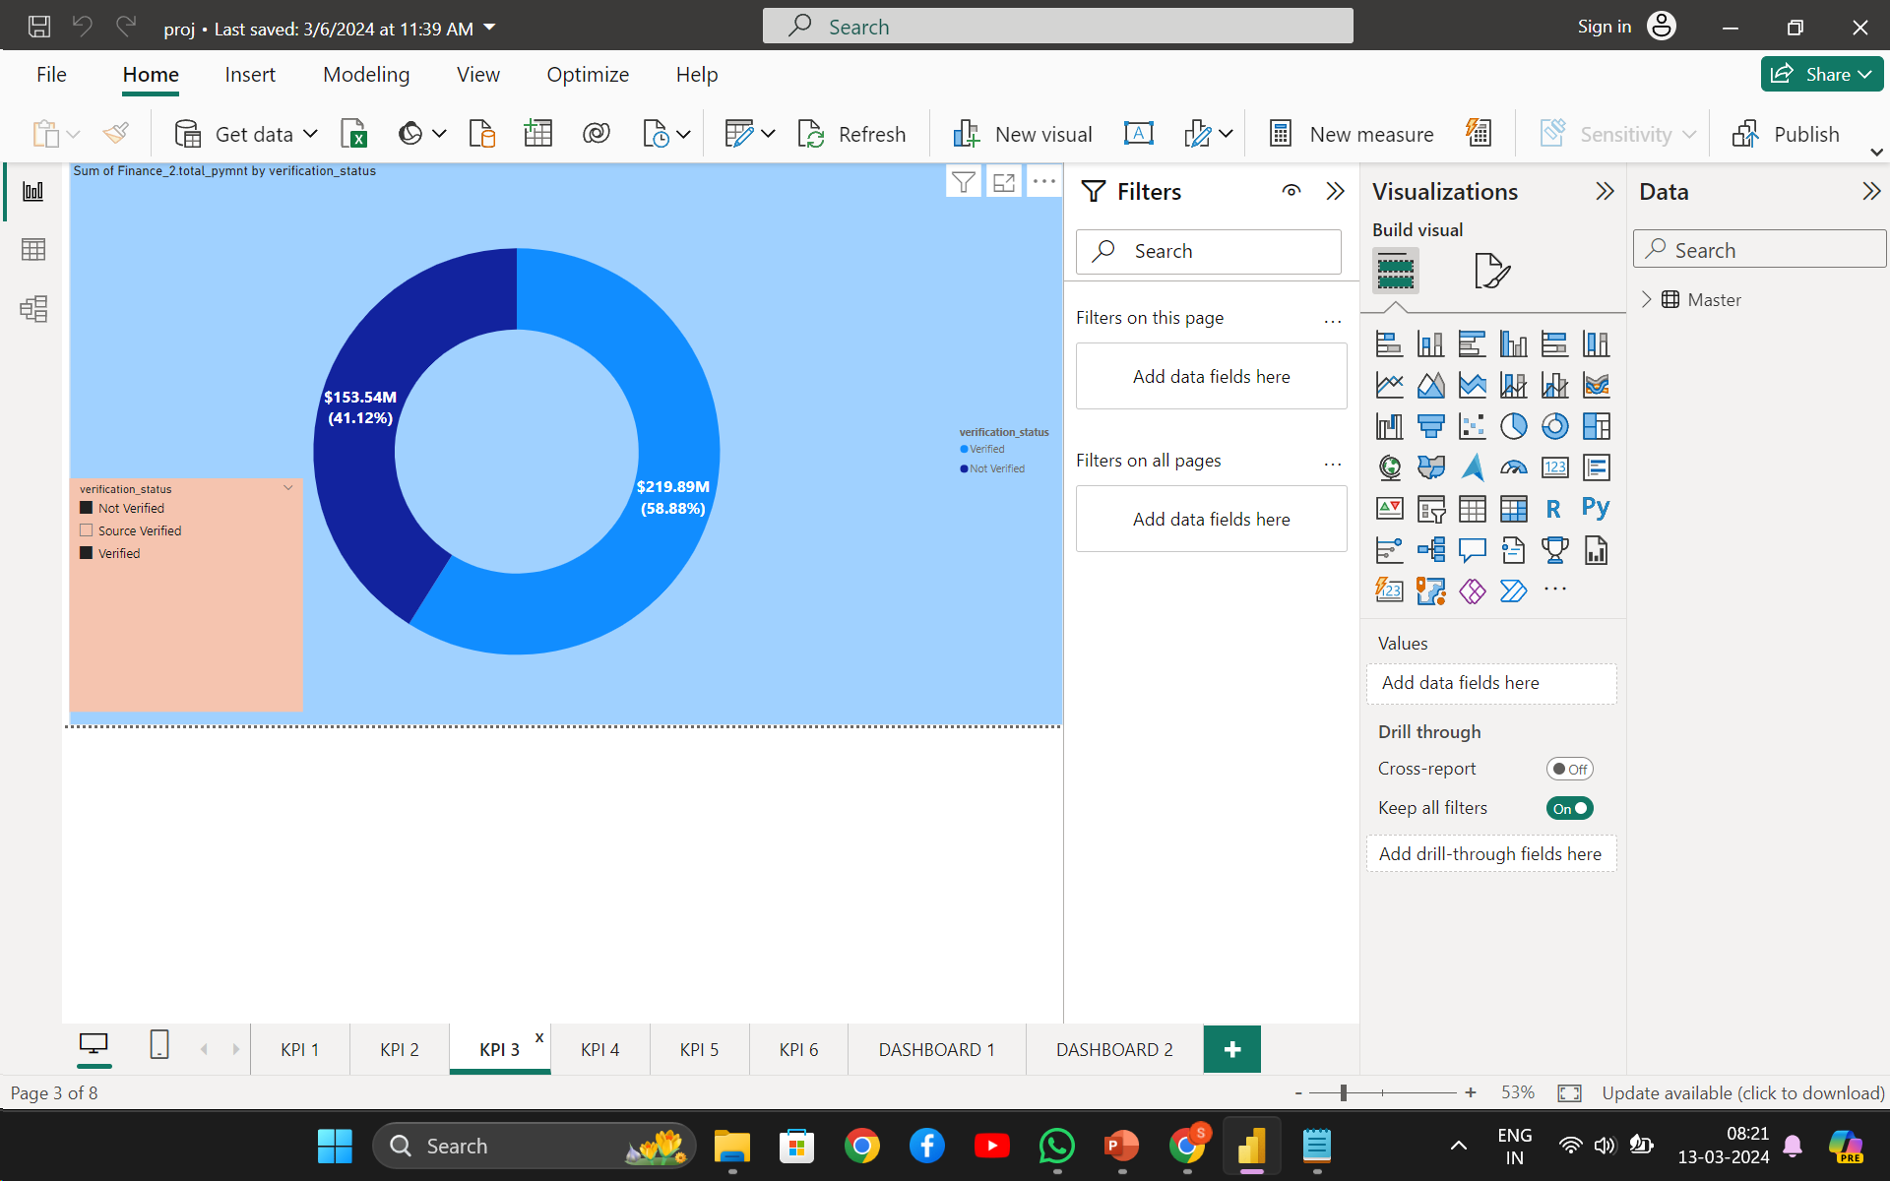
KPI 3: Total payment breakdown for verified and non verified status.
You can see the total annual income for each verification status category, which can help in understanding the distribution of income verification across different categories.
Most of the verification status is verified and source verified.
Loan of purpose of debt consolidation and credit card is not verified that is why revolving balance is more in this category.

Slide 8
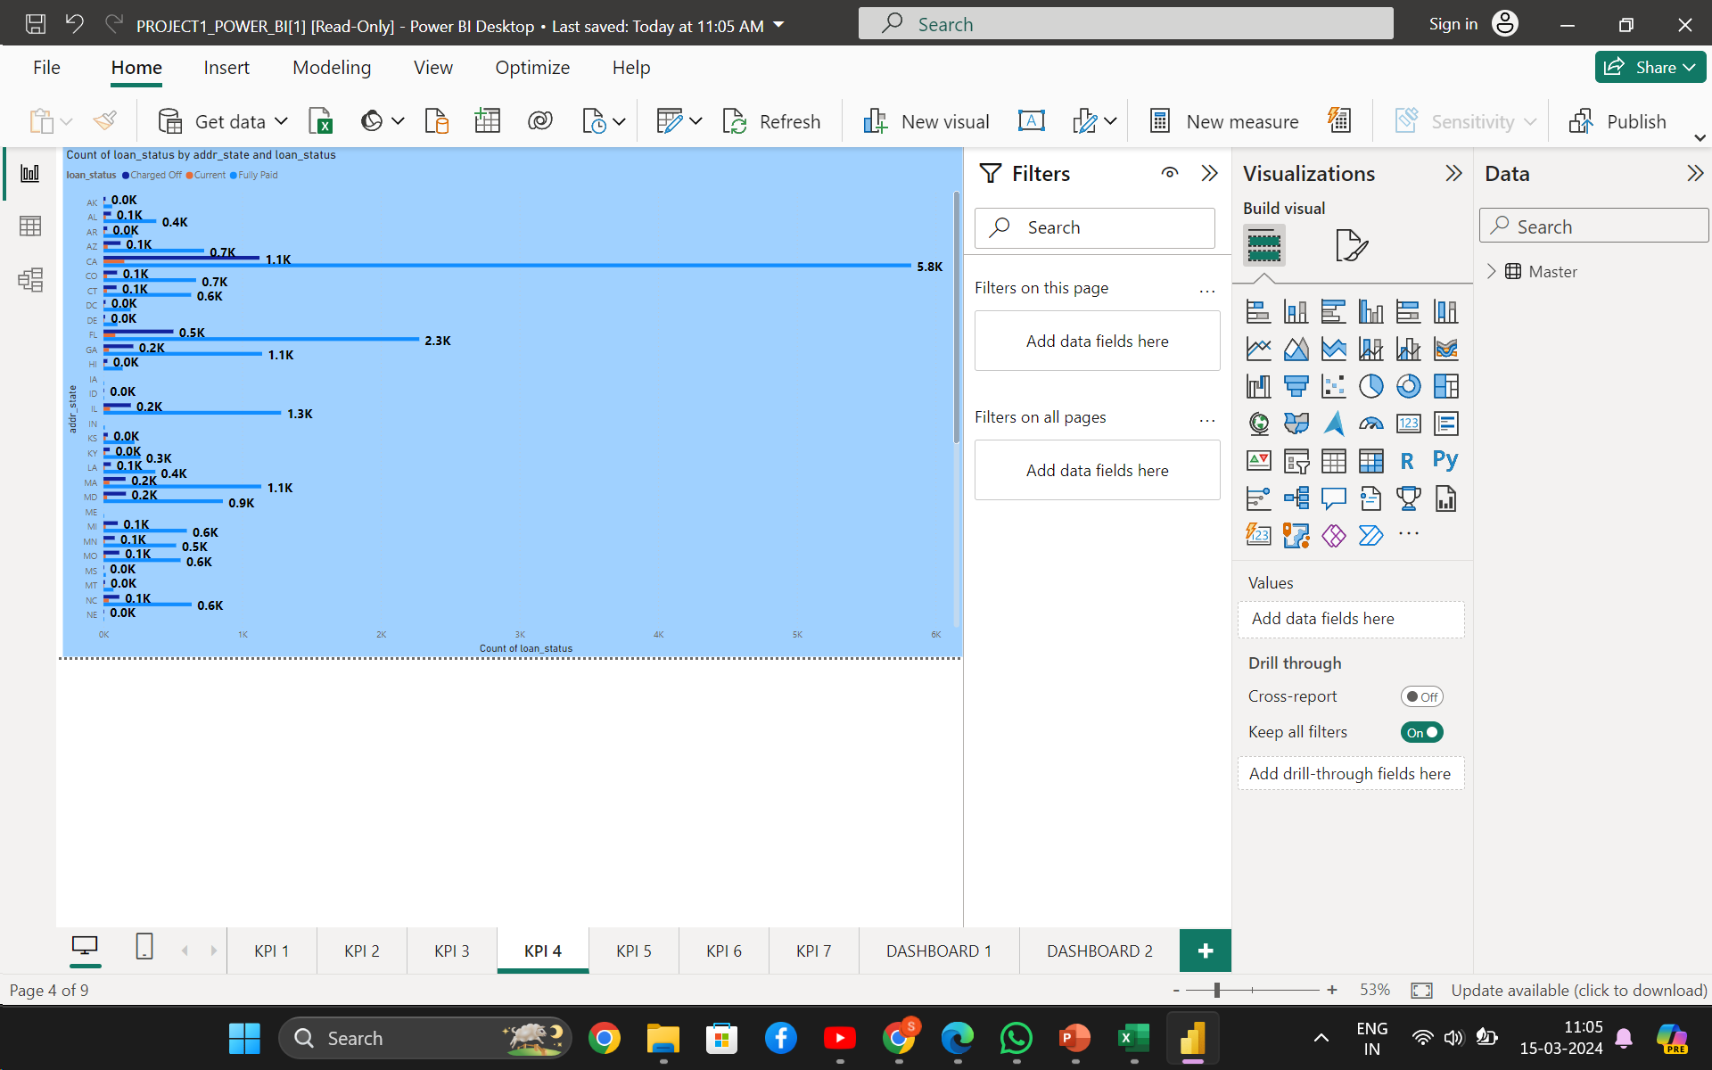
KPI 4 Loan status breakdown : state-wise and month-wise analysis
Loan Status Distribution:
By including the loan status in the GROUP BY clause, you can see the distribution of loan statuses (e.g., fully paid, charged off, etc.) for each state and month.
Comparative Analysis:
We have understood that California(CA) has the highest number of loans (7,099).
Followed by New York(NY) with 3,812 loans and Texas (TX) with 2,727 loans.
This indicates that these states have a relatively higher demand for loans.

Slide 9
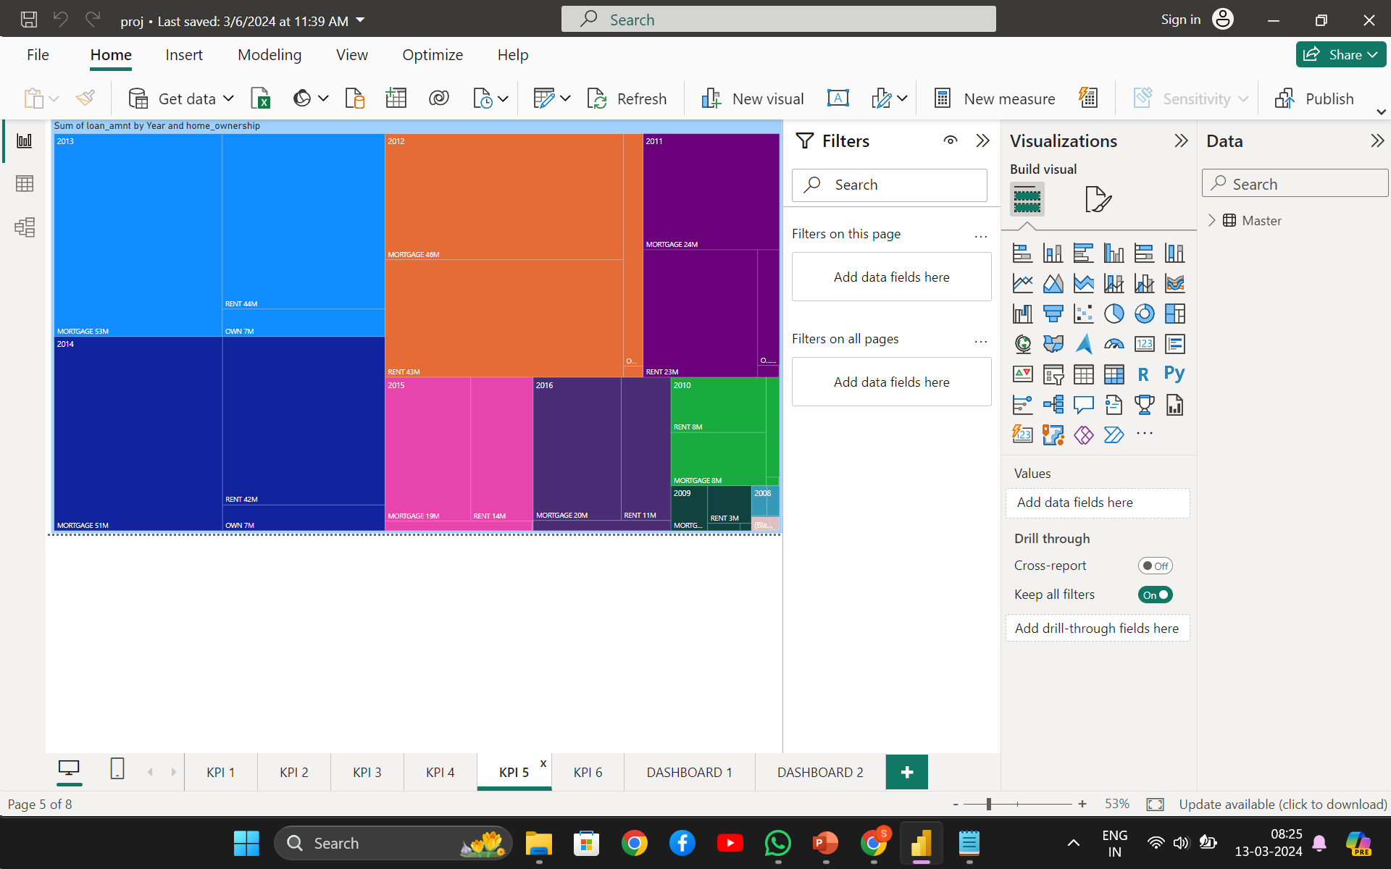
KPI 5:Satastical overview of home ownership
You can see the total payment amount for each home ownership status category, grouped by the last payment date.
This can help in understanding the distribution of payments over time and across different home ownership statuses.
Comparative Analysis:
Mortgage has the highest loan count
Rent is the second most common home ownership status.

Slide 10
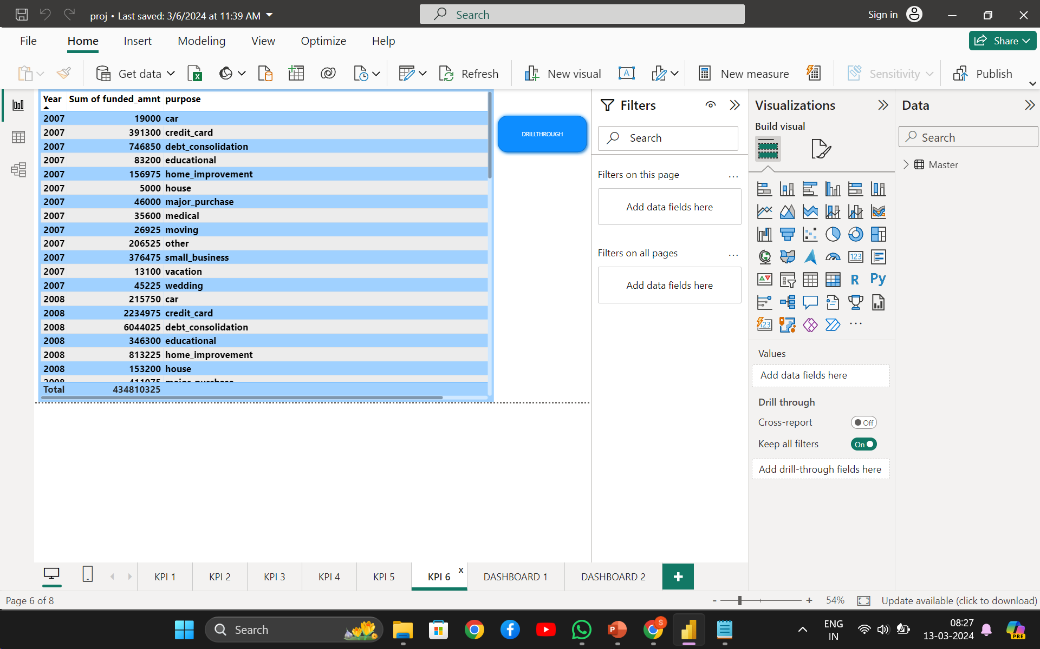
KPI 6: Total funded amount vs Loan Purposes
Loan Issuance Year Breakdown: You can see the total funded amount of loans for each loan issuance year and purpose. This can help in understanding the distribution of funded amounts over time and across different loan purposes.
Comparative Analysis: By comparing the total funded amounts across different loan purposes for each loan issuance year, you can infer which purposes have higher or lower average funded amounts.

Slide 11
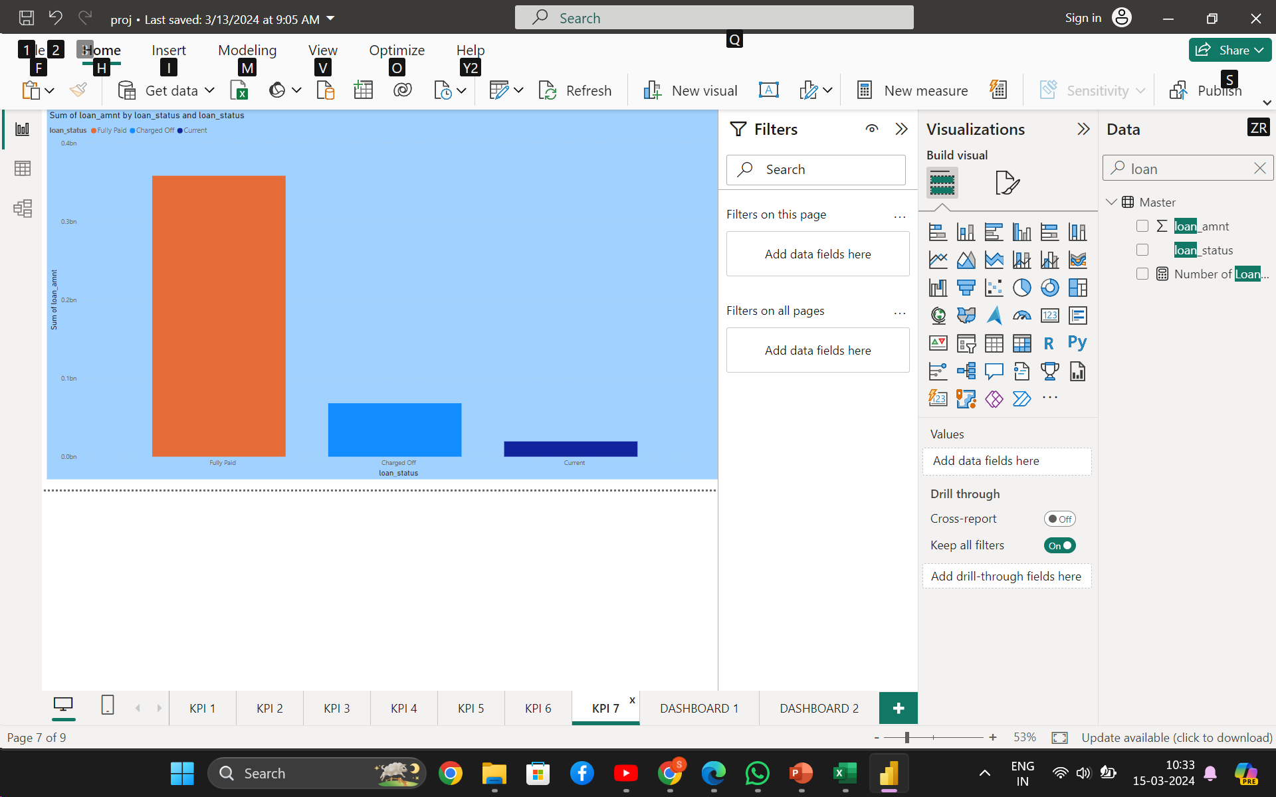
KPI 7: Loan status vs Loan Amount
Portfolio Quality: A higher proportion of loans that have been fully repaid indicates a healthier and more robust loan portfolio. It suggests that the bank has been successful in identifying creditworthy borrowers and issuing loans with favorable terms and conditions.
Risk Management Effectiveness: Loans that have been fully repaid typically represent lower credit risk compared to delinquent or defaulted loans. A high rate of full repayment indicates that the bank's risk assessment processes are effective in evaluating borrower creditworthiness and mitigating default risk.

Slide 12
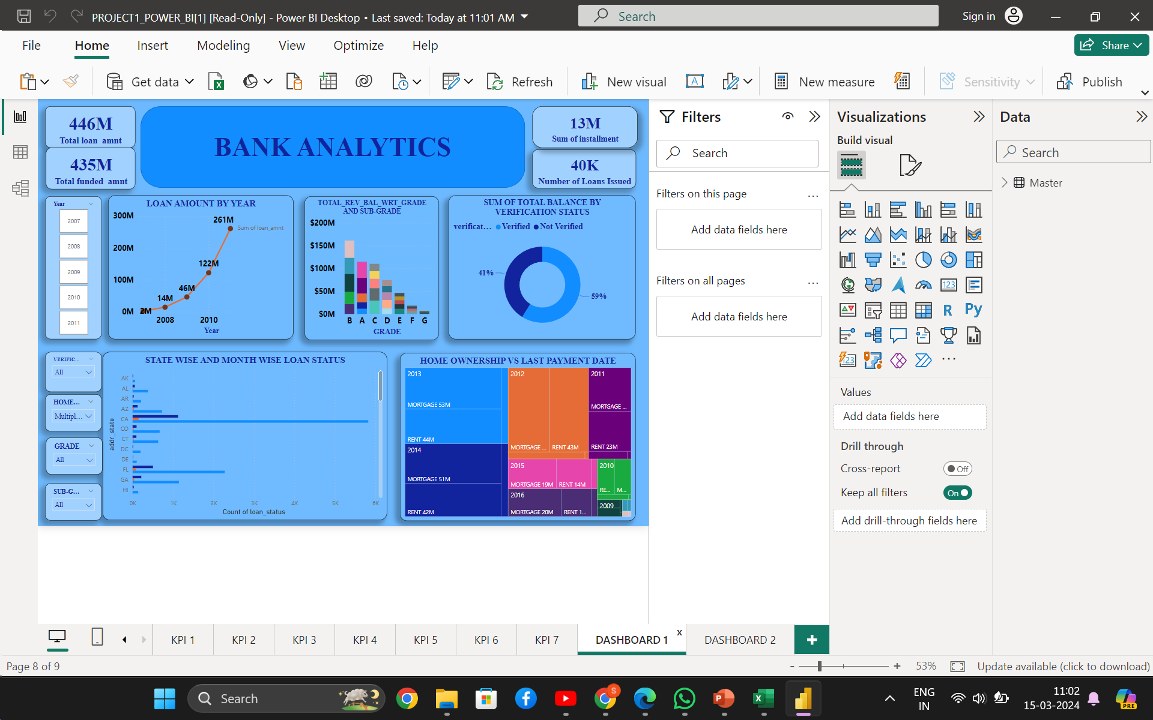
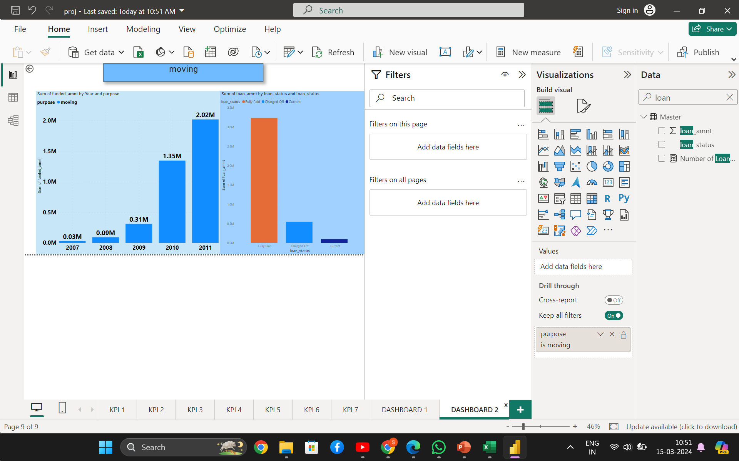
Dashboard 2
Dashboard 1

Slide 13
Recommendations :
Risk Management Enhancement: Utilize the analysis of loan grades, subgrades, and revolving balances to refine risk assessment models. Implement proactive measures to mitigate high-risk loans, potentially reducing default rates and minimizing financial losses.
Optimized Verification Processes: Leverage insights into payment behavior based on verification status to refine the verification process. Streamline and improve verification procedures to enhance the reliability of borrower information, reducing the likelihood of fraudulent activities and improving loan performance.
Geographical Targeting: Use the analysis of state-wise and month-wise loan status to identify regions with higher default rates or lower repayment rates. Tailor marketing strategies and lending practices to address specific regional challenges, potentially improving loan performance and profitability in targeted areas.
Segmented Customer Engagement: Leverage insights into the relationship between homeownership and payment behavior to tailor customer engagement strategies. Offer personalized financial solutions and incentives to homeowners based on their payment patterns, potentially increasing customer satisfaction and loyalty.

Slide 14
THANK YOU
DO YOU HAVE ANY QUESTIONS ?

